Slide 1
APOLO - Cough Covid Challenge
Bitsxlamarató - Hackaton UPC 2020

Slide 2

Who are we?
Arnau Turch Ferreres
Carlos Hurtado Comín
Elías Abad Rocamora
Alex Martí Guiu
(Data Science & Engineering Degree, UPC)

Slide 3
Our Idea
Use CNN with images from Spectrums from the audios

Slide 4
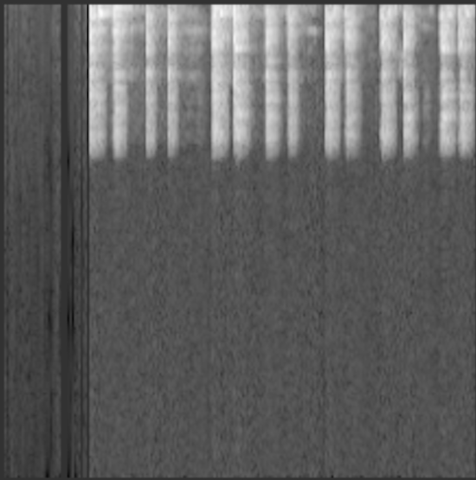
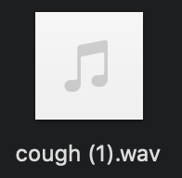
Preprocess - Spectrum
We convert all audio files to an image of its Frequency Spectrum, while reshaping the latter so that all images are the same dimensions

Slide 5
Learning from scratch - Cough
Quite Slow
model = nn.Sequential(
nn.Conv2d(1, 64, 3),
nn.ReLU(),
nn.MaxPool2d(2),
nn.Conv2d(64, 128, 3),
nn.ReLU(),
nn.MaxPool2d(2),
nn.Conv2d(128, 256, 3),
nn.ReLU(),
nn.MaxPool2d(2),
nn.Conv2d(256, 256, 3),
nn.ReLU(),
nn.MaxPool2d(2),
nn.Flatten(),
nn.Linear(256*5*5, 512),
nn.ReLU(),
nn.Linear(512, 1),
nn.Sigmoid()
)
We have reached 100% train and 85% test accuracies with 60 epochs.

Slide 6
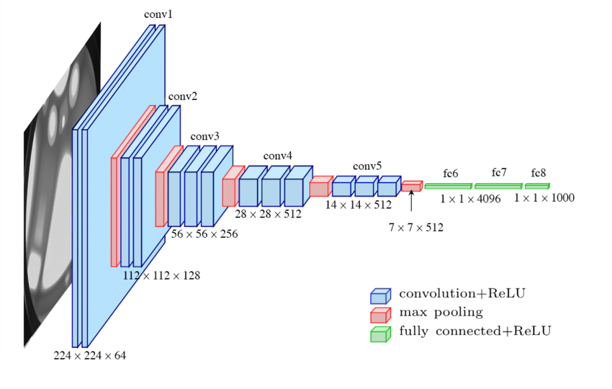
Transfer learning from VGG16
We have performed transfer learning from the already trained weights of VGG16, and frozen the feature extraction layers while trained an MPL on top of them. It f***ing flies, very fast! :)
We have reached 99% train and 87.5% test accuracies and 10 epochs

Slide 7
Transfer learning from VGG16
We have reached 80% train and 82.5% test accuracies and 2 epochs
We have reached 65% train and 62.5% test precisions
We have reached 90% train and 83% test precisions

Slide 8
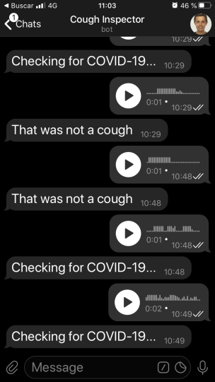
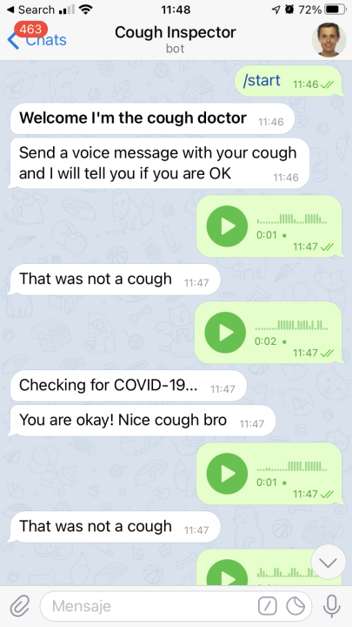
Telegram Bot - Both models implemented

